Slide 1
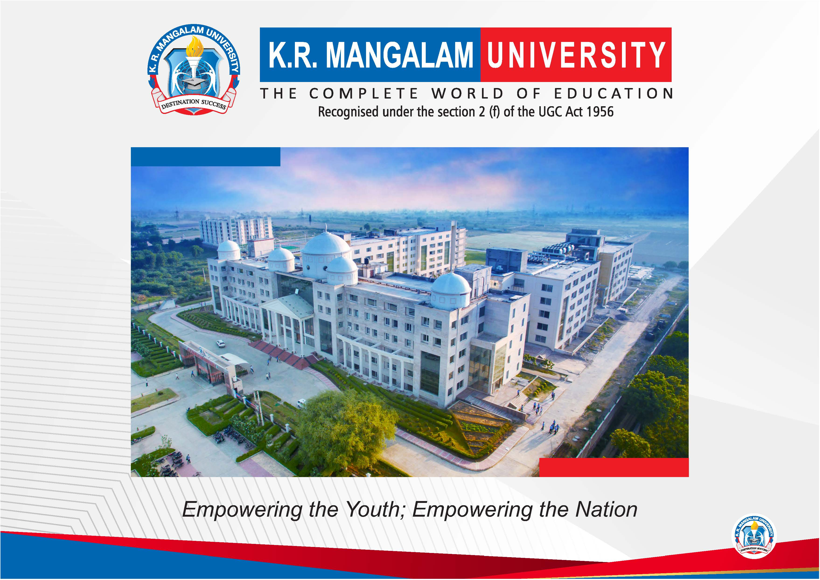

Slide 2


EcoBin Master
2nd Semester Project Synopsis
Submitted by
ROLL | NAME
2301560040 | Keshav Kumar
2301560066 | Sheran
2301560069 | Yash Gupta
2301560064 | Shiv Shankar Kumar
Industry Mentor: Project Code:
Faculty Mentor: Dr. Saneh Lata Yadav YR I-259
Notes:
New Courses replaced with New Programmes

Slide 3

Project Overview
The Waste Classification Data Management and Analysis Project aim to revolutionize waste management practices by systematically organizing, analyzing, and categorizing data related to various types of waste. The project's primary focus is to enhance understanding, optimize recycling efforts, and minimize environmental impact in [specific region/community/industry].
The project will leverage deep learning algorithms and neural networks to enhance the accuracy and efficiency of waste classification. By training models on vast datasets, the system aims to autonomously identify and categorize waste types, providing real-time insights into evolving waste patterns.
Notes:
New Courses replaced with New Programmes

Slide 4
Specific Objectives
Develop a comprehensive classification system to categorize different types of waste based on their composition, origin, and potential environmental impact.
Collect and analyze data to quantify the volume and characteristics of different waste streams, including municipal waste, industrial waste, electronic waste, and hazardous waste.
We Ensure that the EcoBin master system aligns with and facilitates compliance with local, regional, and national waste management regulations and standards
Notes:
New Courses replaced with New Programmes

Slide 5
Key Features
1. Scan the waste
EcoBin Master revolutionizes waste management, simplifying the process of sorting and disposing of waste. With our platform, users can effortlessly.
2. Waste Sorting Game
Our waste sorting game is an interactive and engaging experience designed to educate and challenge users in the art of proper waste disposal. Players are tasked with sorting various items into their respective recycling bins within a time limit, earning points for each correct placement.
Notes:
New Courses replaced with New Programmes

Slide 6
Project Usecases & Scope
Integration with EcoBin Master System
Collaborate with municipalities and waste management companies to integrate with EcoBin Master System.
By connecting the platform to IoT-enabled bins and sensors, users could receive real-time updates on bin capacities, collection schedules, and recycling rates in their area, fostering greater community engagement and efficiency in waste collection and recycling processes.
Community Waste Exchange Platform
Expand EcoBin Master to include a virtual marketplace where users can exchange or donate unwanted items to others in their community.
By facilitating the reuse and redistribution of goods, this feature encourages a circular economy and reduces the amount of waste sent to landfills.
Notes:
New Courses replaced with New Programmes

Slide 7
Prototype/Project Flow diagram/Architecture
Source Task/Domain
Classification
Dataset
Multi-Class SVM
Transfering learnt weight for a new target
Model
Learned
From Task
Model
model
Learnable Weights
Knowledge
Notes:
New Courses replaced with New Programmes

Slide 8



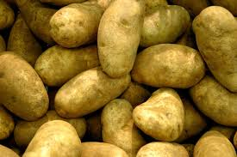




Data & Resources
We are using Waste classification data from Kaggle. This dataset contains 22500 images of organic and recyclable objects.
(a). Potato
(b). Bottle
(c). Paper
(d). Cartine
Notes:
New Courses replaced with New Programmes

Slide 9
Methodology
1. Scan the waste
Language:- Python
Deep Learning Framework:- TensorFlow & Keras
Activation function:- SoftMax
Library:- NumPy, Matplotlib
2. Waste Sorting Game
HTML, CSS, JavaScript
Notes:
New Courses replaced with New Programmes

Slide 10
Expected Results & Impact
Improved Waste Classification Accuracy:- The Integration of deep Learning and neural networks is expected to significantly enhance the accuracy of waste classification, reducing manual errors and providing a more comprehensive understanding of waste composition.
Enhance Recycling Efforts:- By identifying high-priority waste streams for recycling through advanced data analysis, the project anticipates a measurable increase in recycling rates and resource recovery, contributing to a more circular and sustainable economy.
Environmental Sustainability:- The project's focus on accurate waste classification and optimized recycling efforts is poised to significantly reduce the environmental impact associated with improper waste disposal. This contributes to the overall sustainability goals of the [specific region/community/industry].
Notes:
New Courses replaced with New Programmes

Slide 11
THANK YOU

